Slide 1

Stock Market
Roque moreno Jesica marlen

Slide 2

Las faang

Slide 3
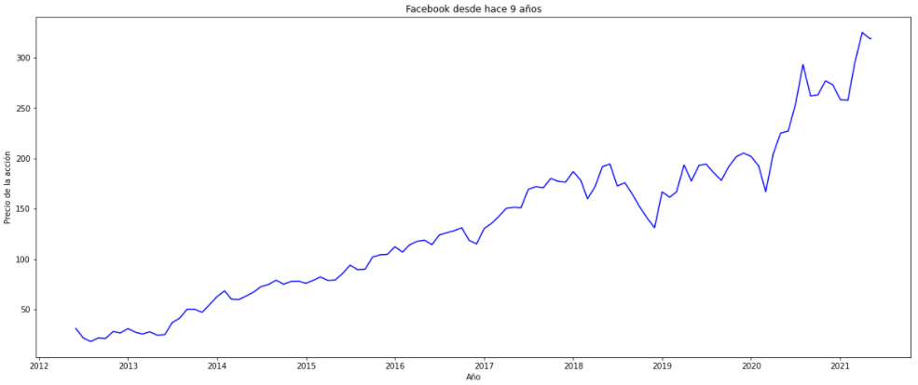
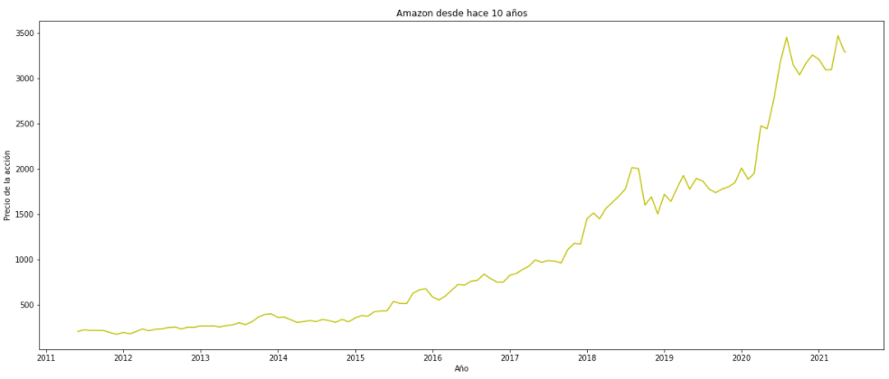
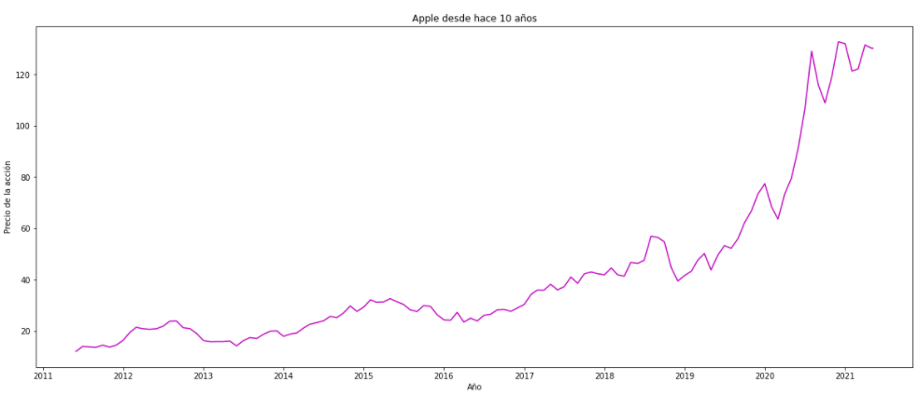
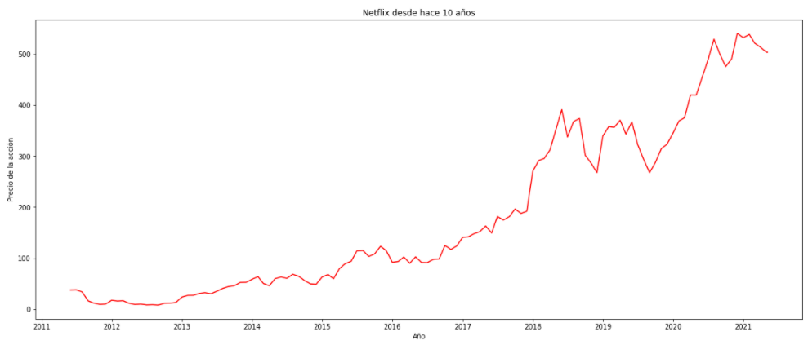
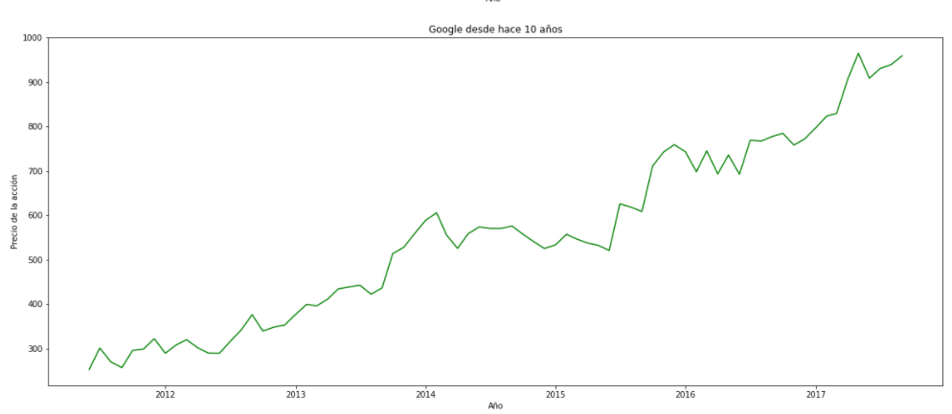
Rendimiento
Facebook
Amazon
Apple
Netflix
Google

Slide 4
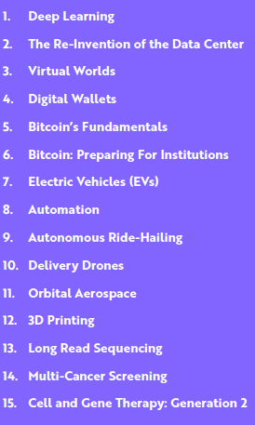
ARK - Drivers

Slide 5
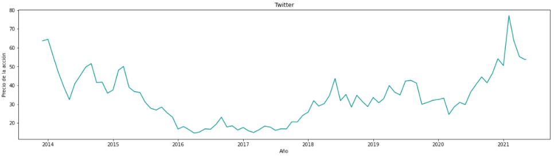
Deep learning
Facebook
Pinterest
Twitter

Slide 6
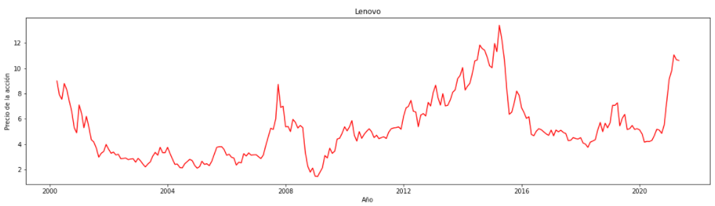
The Re-Invention of the Data Center
Dell Technologies
Lenovo
Huawei

Slide 7

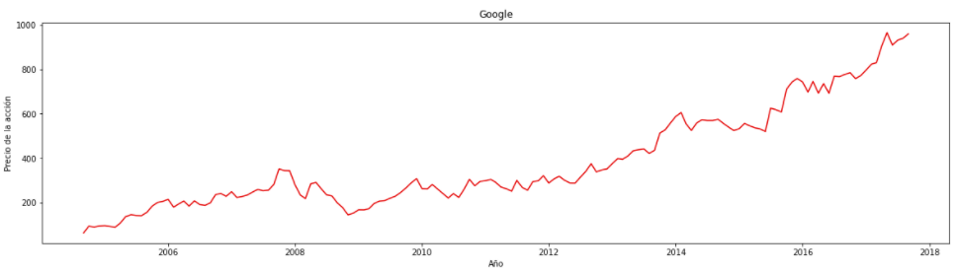
Virtual Worlds
Google
Apple
Microsoft

Slide 8

Digital Wallets
Bloackchain
Coinbase
Trust Wallet

Slide 9
Bitcoin’s Fundamentals
Amazon
Dell Technologies
Coinbase

Slide 10
Bitcoin: Preparing For Institutions
Coinbase
Apple
Tesla

Slide 11
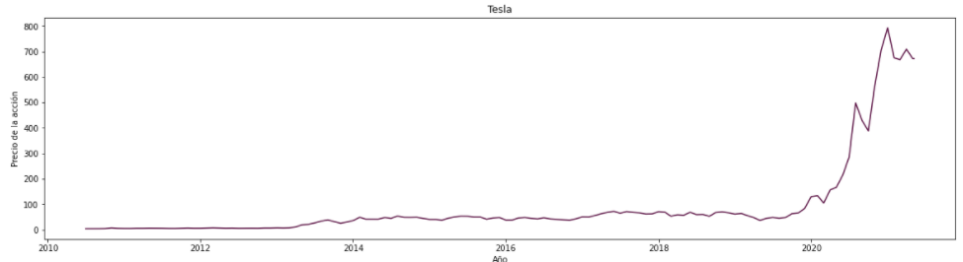
Electric Vehicles (EVs)
Tesla
Nissan
BMW

Slide 12

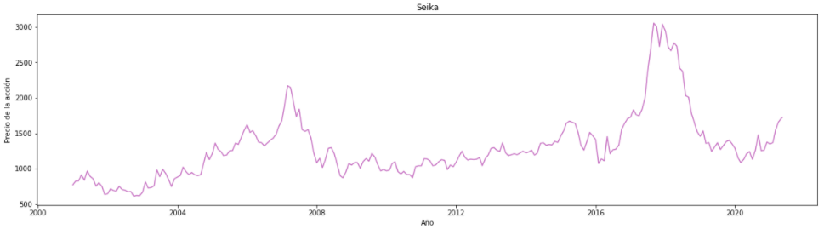
Automation
Epson
Google
Seika

Slide 13
Autonomous Ride-Hailing
Tesla
Apple
BMW

Slide 14
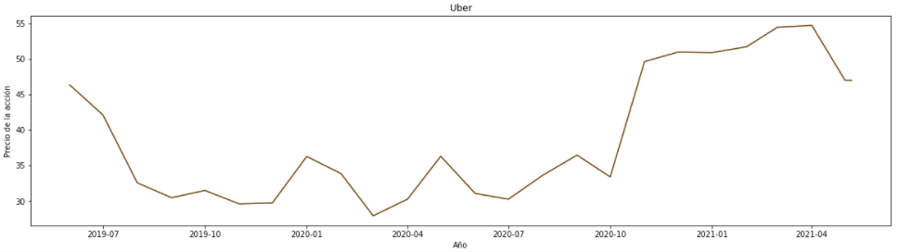
Delivery Drones
Amazon
Uber
Google

Slide 15
Orbital Aerospace
Airbus
Spirit AeroSystems
AeroVironment

Slide 16
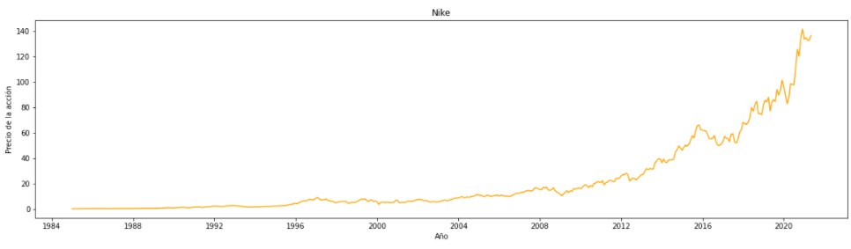
3D Printing
Nike
Hasbro
Ford

Slide 17
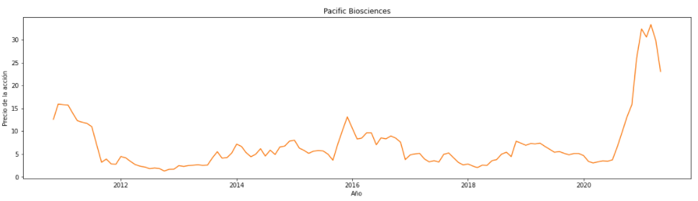
Long Read Sequencing
Google
Pacific Biosciences
NanoString

Slide 18
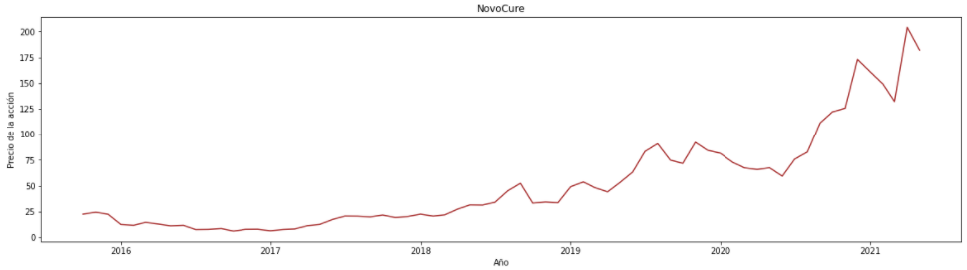
Multi-Cancer Screening
Illumina
NovoCure
Nirati Therapeutics

Slide 19
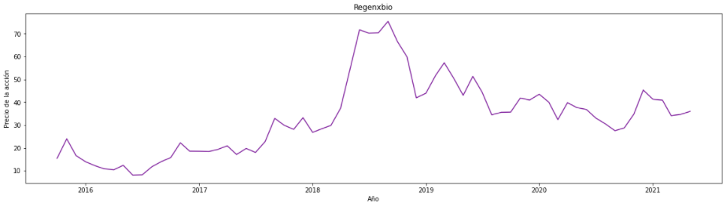
Cell and Gene Therapy: Generation 2
Cord Blood Center
Regenxbio
uniQure

Slide 20
Referencias
ARK-Invest. (2021). Big Ideas 2021. 9/05/2021, de ARK-Invest Sitio web: https://ark-invest.com/big-ideas-2021/
Biothec. (2020). 10 Top Oncology Companies. 9/05/2021, de investiguetinnews Sitio web: https://investingnews.com/daily/life-science-investing/biotech-investing/top-oncology-companies/
FDA. (S.F). Approved Cellular and Gene Therapy Products. 9/05/2021, de FDA Sitio web: https://www.fda.gov/vaccines-blood-biologics/cellular-gene-therapy-products/approved-cellular-and-gene-therapy-products
Investopedia. (S.F). 10 Stocks For The Gene Therapy Revolution. 9/05/2021, de Investopedia Sitio web: https://www.investopedia.com/10-stocks-for-the-gene-therapy-revolution-4588910
IT Renting. (S.F). Entregas a domicilio con drones, ¡más rápido que nunca!. 9/05/2021, de IT Renting Sitio web: https://itrenting.com/entregas-a-domicilio-con-drones/
Illumina. (2020). Illumina Announces the NovaSeqTM 6000 v1.5 Reagent Kit Unlocking Deeper Discoveries with the $600 Genome. 9/05/2021, de Illumina Sitio web: https://www.illumina.com/company/news-center/press-releases/2020/9c48adf5-5b78-4e18-8116-3c7c8b3ad79f.html
IMPRESORAS3D.COM. (S.F). 10 empresas que utilizan la impresión 3D de forma innovadora. 9/05/2021, de Impresoras3D Sitio web: https://www.impresoras3d.com/10-empresas-que-utilizan-la-impresion-3d-de-forma-innovadora/
Administrador. (2017). Drones en México para entregas a domicilio. 9/05/2021, de Omega Drone Sitio web: https://omegadrone.com.mx/drones-en-mexico-para-entregas-a-domicilio/
Miriam Blanco. (2019). Descubre las 3 marcas de coches autónomos más importantes. 9/05/2021, de GeekOn Sitio web: https://www.geekno.com/descubre-las-marcas-de-coches-autonomos-mas-importantes.html
Expansión. (2019). Pinterest se une al tablero de la Bolsa mexicana. 9/05/2021, de Expansión Sitio web: https://expansion.mx/mercados/2019/08/14/pinterest-se-une-al-tablero-de-la-bolsa-mexicana

